Slide 1
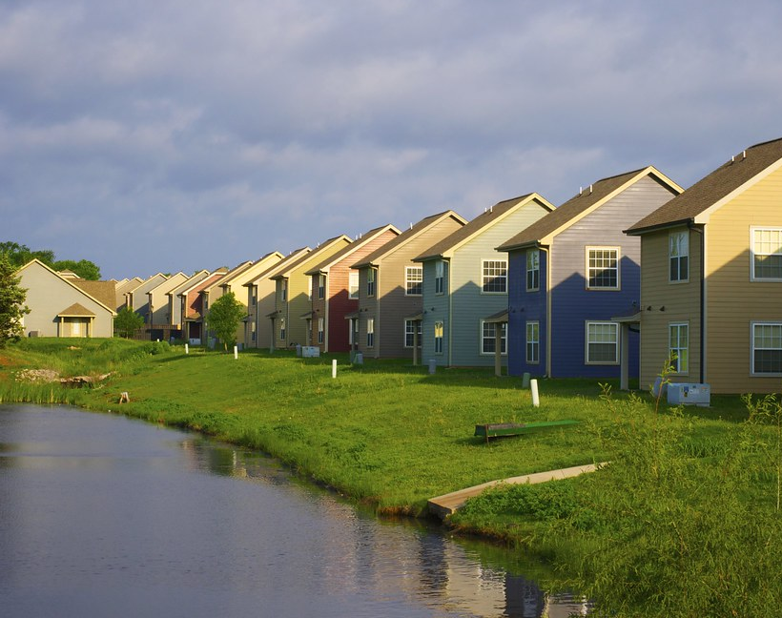
Property Shark
-Shriya Veluru
Mounika Koduri
This Photo by Unknown author is licensed under CC BY-NC-ND.

Slide 2

Property Shark
Property shark is a web application where tenants and owners meet and they have varied options to choose from.
Owners would be able to post their listings and the tenants would be able to choose the apartments according to their requirements and budget.

Slide 3

REQUIREMENTS
On the index page, the user would have to choose if they want to register or login.
Being able to add listings as an owner in the specified locality.
Being able to search for properties based on the tenants priorities.
The tenants should be able to save the preferences or later delete them.

Slide 4

KEY DESIGN FEATURES
Session
A session will be kept for the user based on the username and password when they login.
Only when the user logs off of the website will the session come to an end.
UI
The options that the tenants have to search and save according to their preferences.
Owner being able to post all his advertisements and being able to see the requests from the tenants.

Slide 5

AGILE SCRUM METHODOLOGY
Develop in Sprints
Review after each sprint.
Update accordingly.

Slide 6
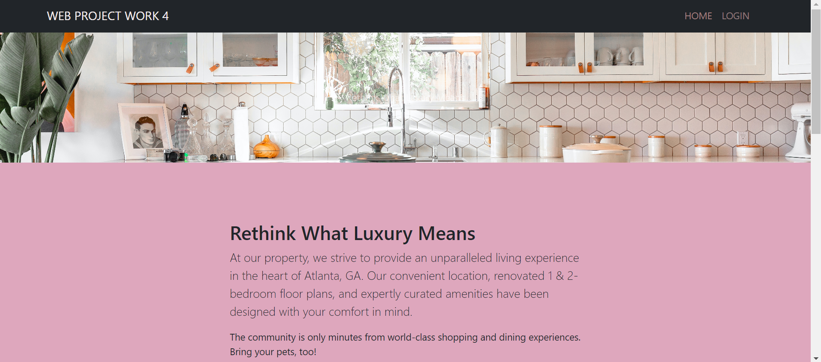
USER INTERFACE:
THE INDEX PAGE:

Slide 7
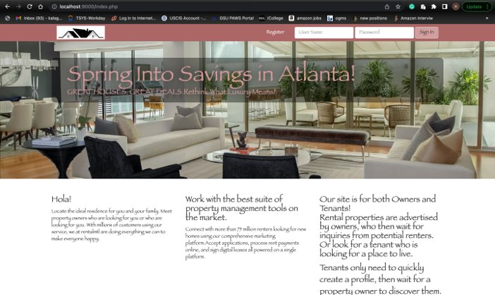
THE LOGIN PAGE

Slide 8
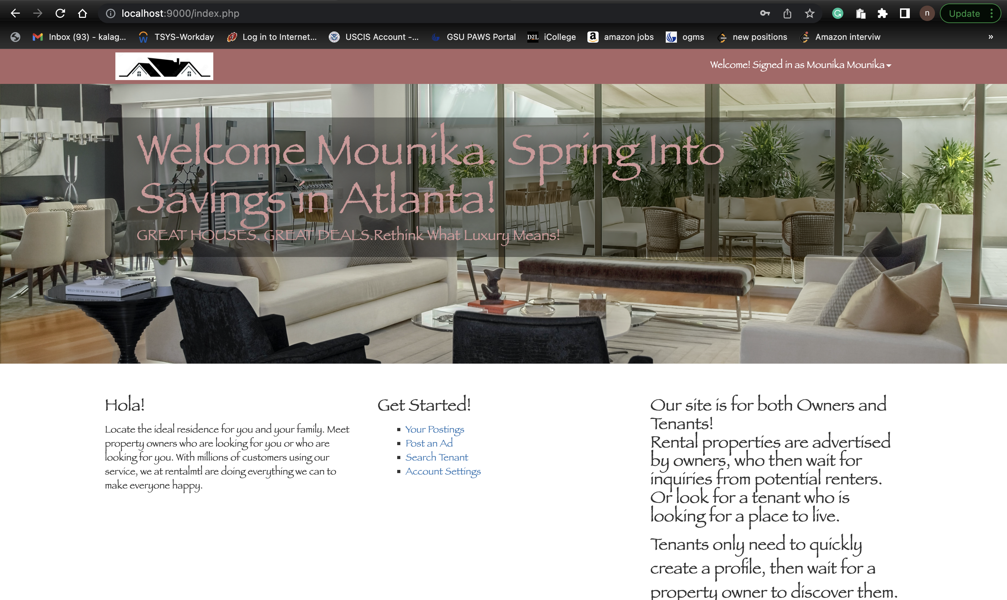
AFTER LOGING INTO THE ACCOUNT

Slide 9
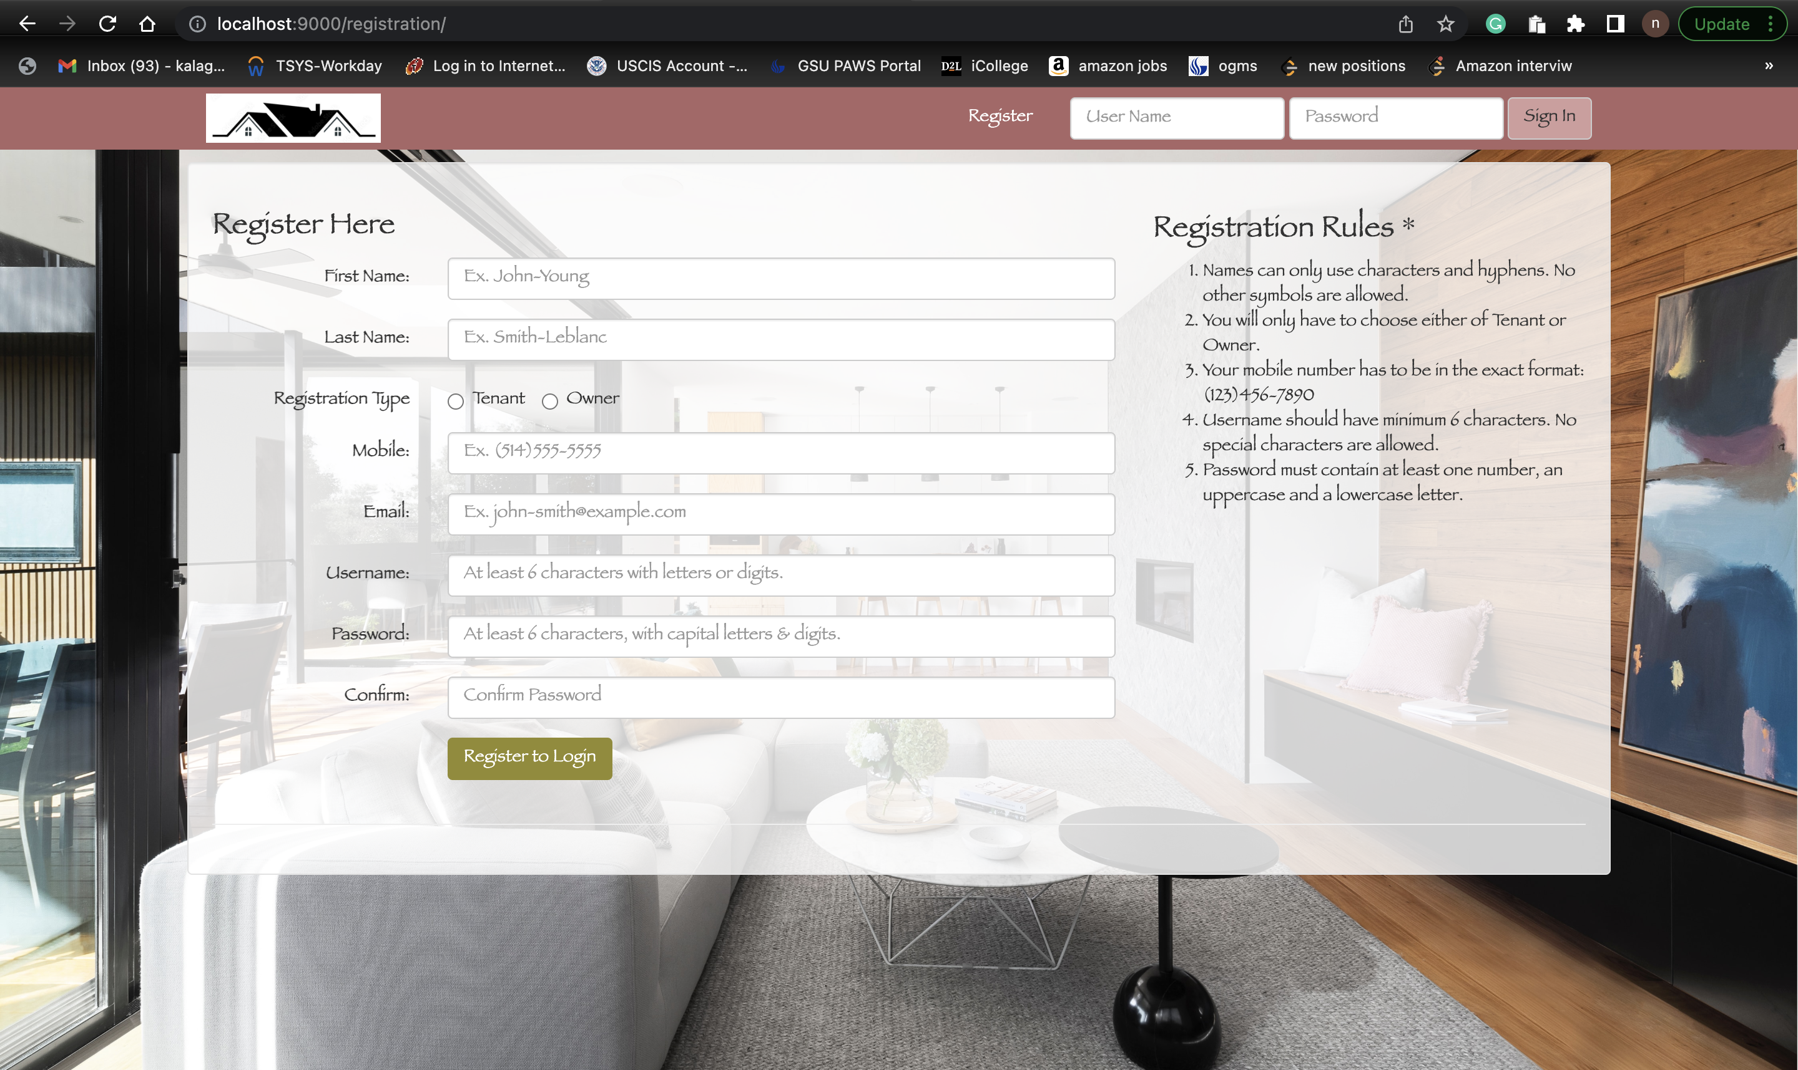
REGISTRATION

Slide 10
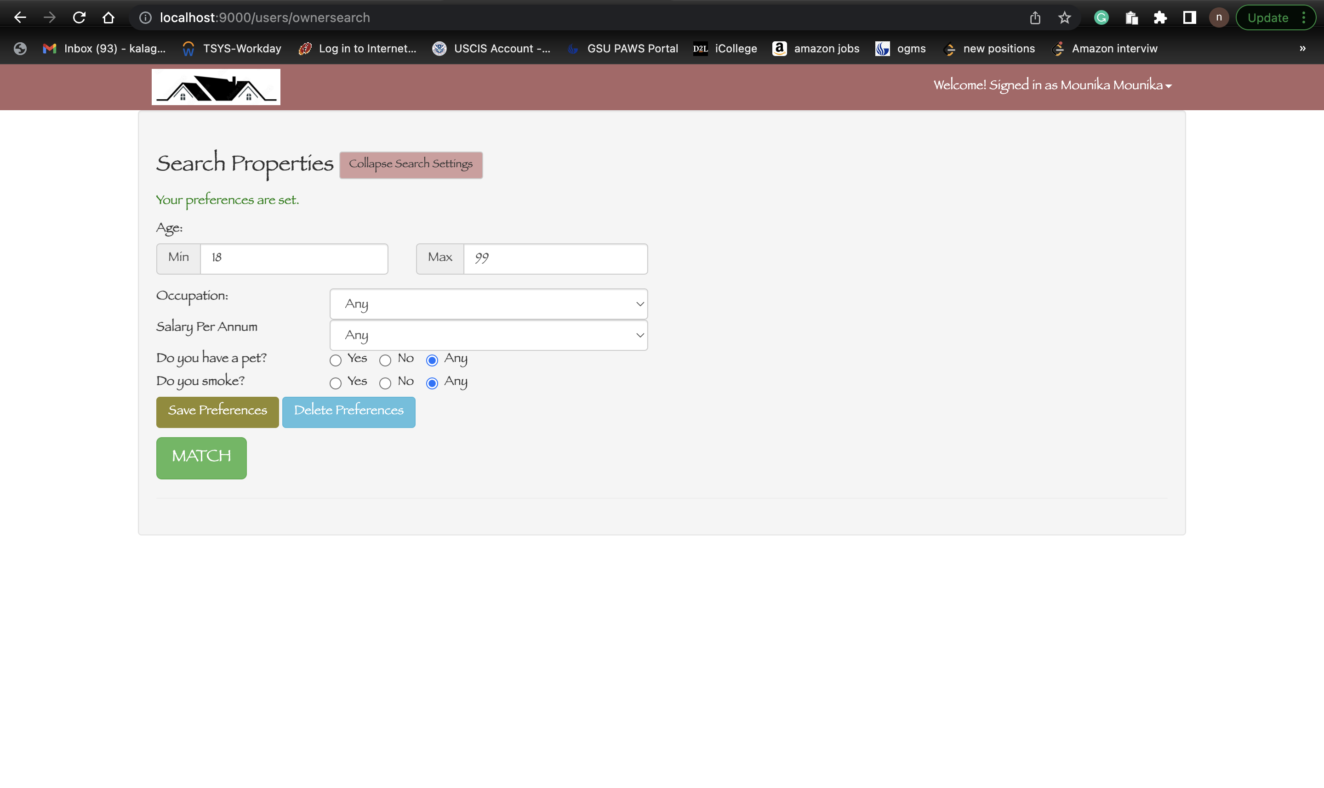
OWNER SEARCH

Slide 11
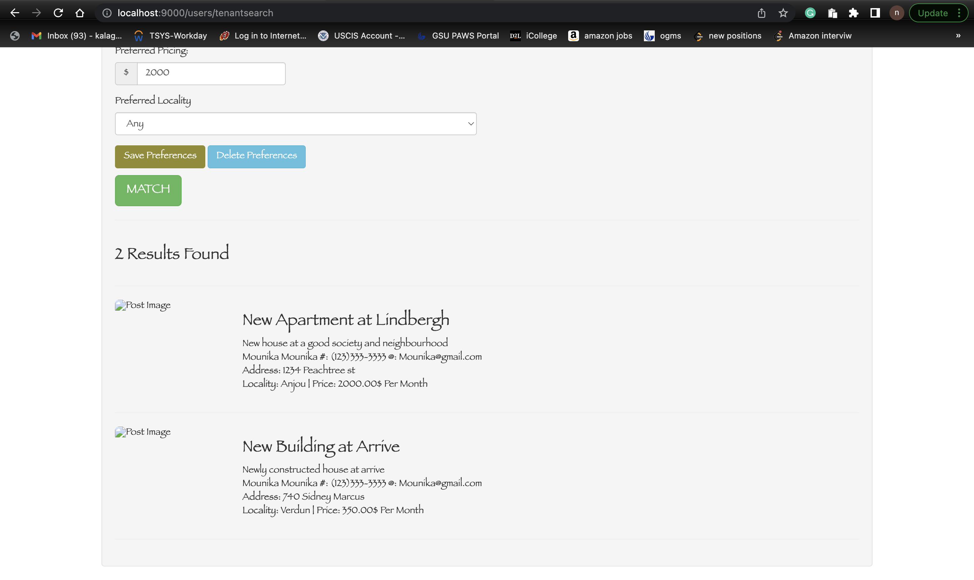
TENANT SEARCH

Slide 12
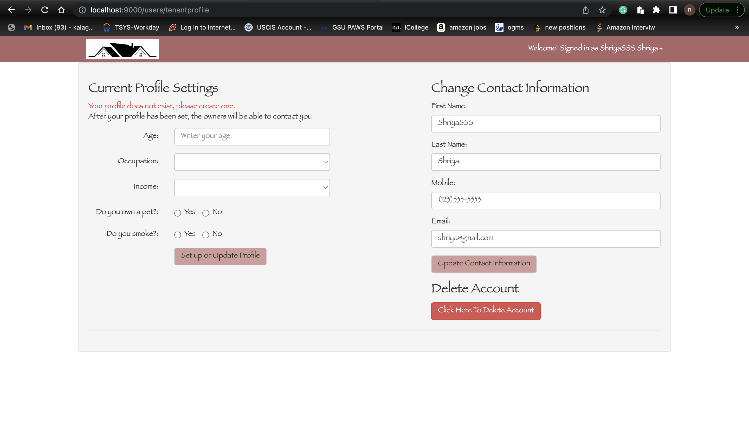
TO UPDATE TENANT PROFILE:

Slide 13
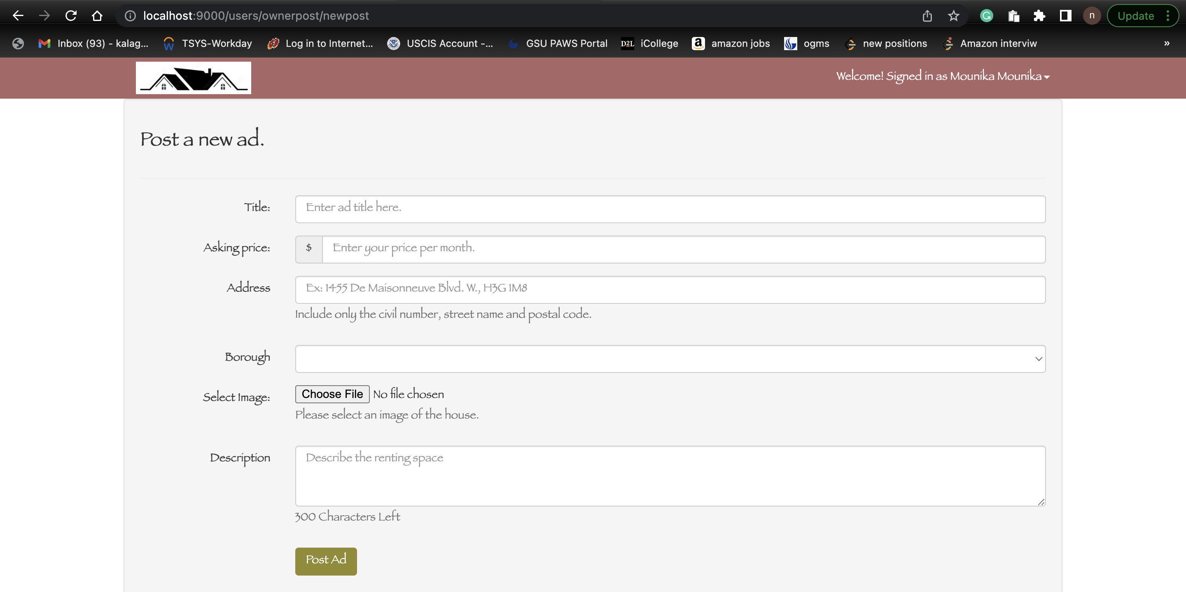
TO CREATE A POST BY OWNER:

Slide 14
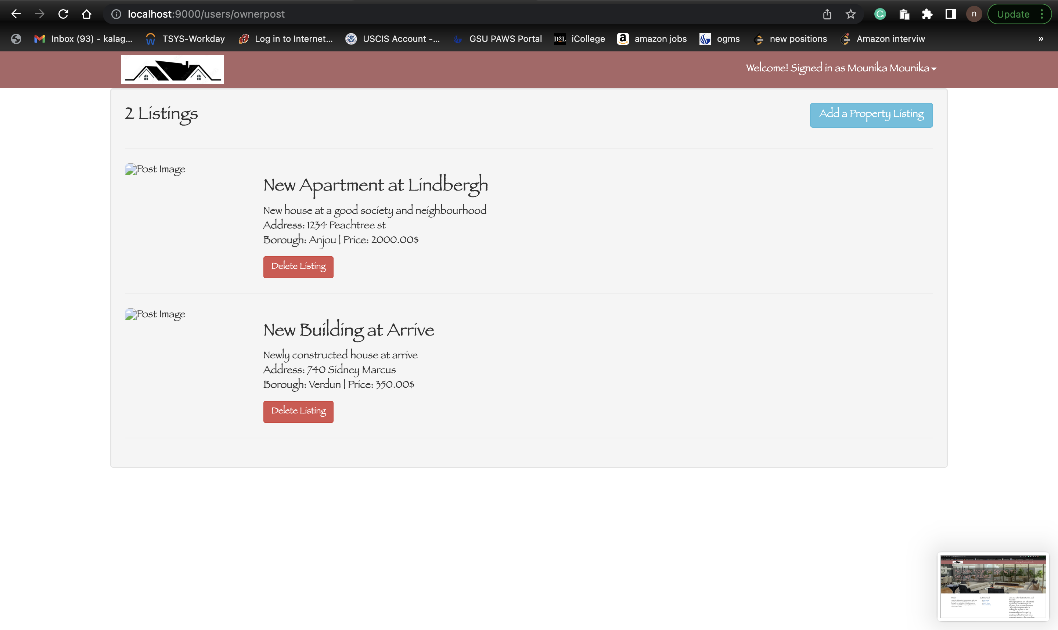
OWNER POSTS:

Slide 15
ADDING PREFERENCES

Slide 16
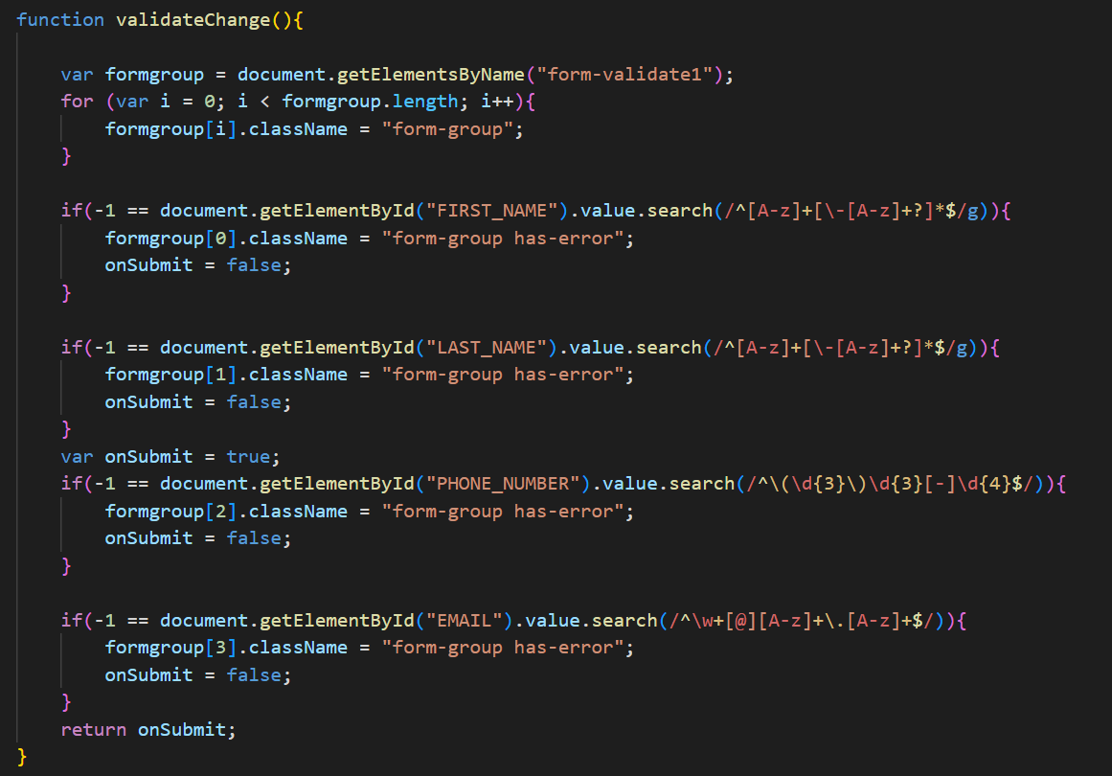
CODE SNIPPETS:
OWNER SEARCH
VALIDATION

Slide 17
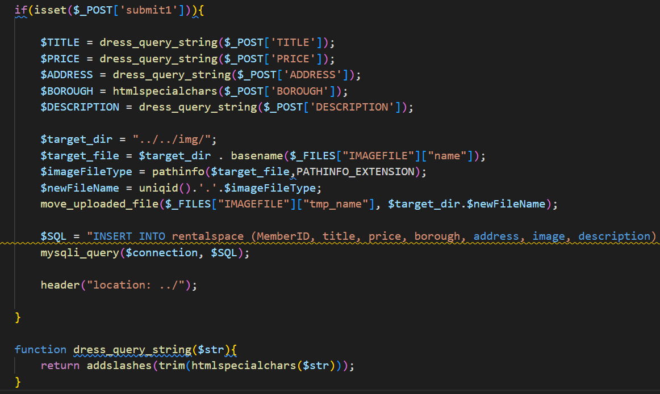
SUBMITTING A POST TO THE DB:

Slide 18
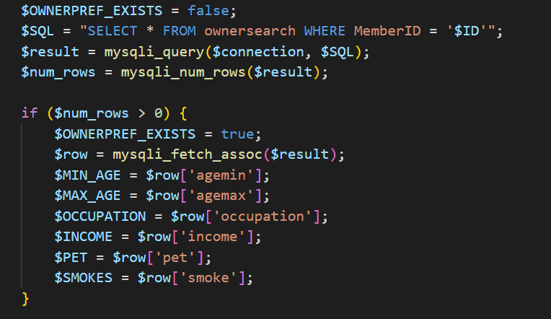
OWNER PREFERENCE

Slide 19
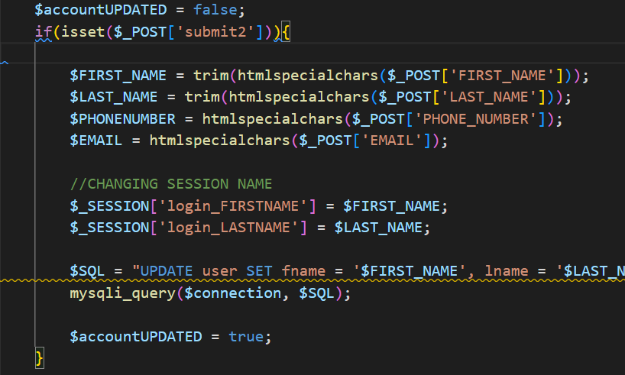
UPDATING TENANT DETAILS:

Slide 20
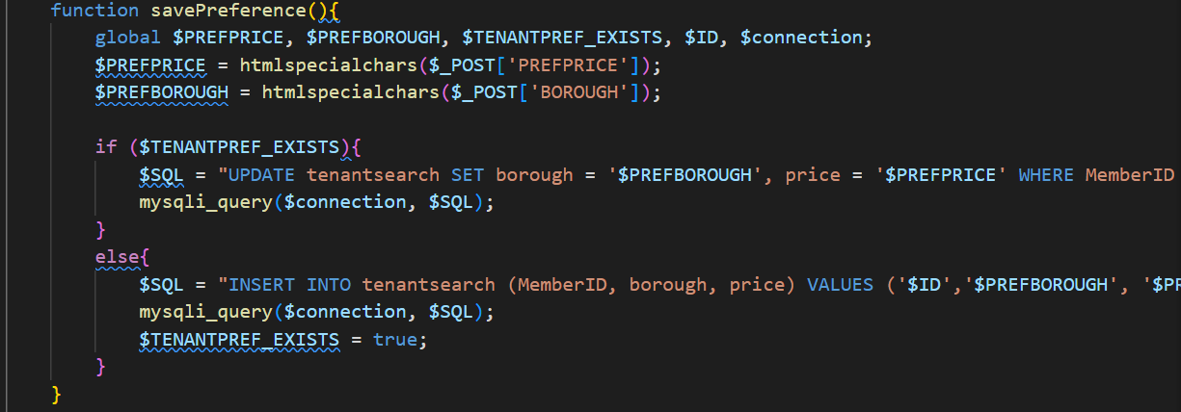
TO SAVE TENANT PREFERENCE:

Slide 21

DEMO

Slide 22

THANK YOU

